Slide 1
Photojournalism

Slide 2
What is PHOTOJOURNALISM?
Artistic expression that informs citizens about: -their community, the nation, the world -current affairs -social issues

Slide 3
...what is the goal of a photojournalist?

Slide 4
To inform!

Slide 5
Photojournalists…

Slide 6
...are professionals who work for magazines, newspapers, photography agencies or television production companies etc.

Slide 7
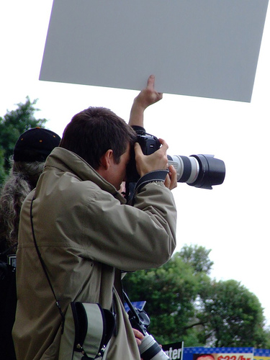

Slide 9
How can I capture an image as a photojournalist?

Slide 10
TIP 1: Look for emotion or expression

Slide 14
TIP 2: Factor in Point of View

Slide 15
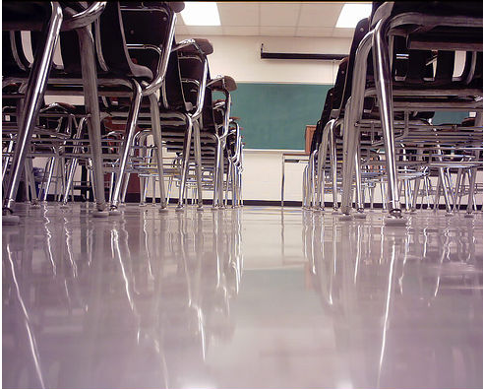

Slide 17
TIP 3: Isolate your subject
…Picking one person in a crowd can create a very strong subject and image.

Slide 21
TIP 4: Try different angles

Slide 25
TIP 5: Try lines that lead the eyes.

Slide 26
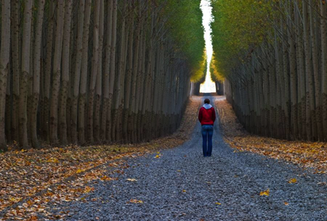

Slide 27
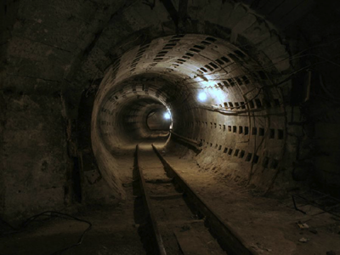

Slide 28
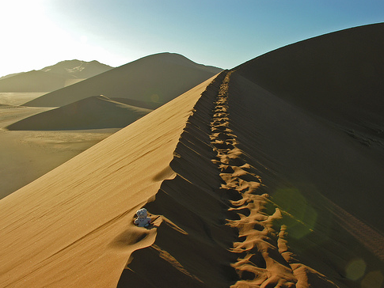

Slide 29
Black & White

Slide 30
“Black and white treads that fine line between reality and fantasy.”

Slide 31
When an image is very graphic.
When the colors of the image are not very alluring.
When we want to make it more dramatic.

