Slide 2
What is MEDIA?

Slide 3
new vs. old

Slide 4
…social media?

Slide 6
Media literacy?

Slide 7
Technically, it is…
The ability to bring critical thinking skills to bear on all media. It is the ability to interpret and value media content and to understand media's cultural, political, commercial and social implications.

Slide 8
Media education?

Slide 9
The process through which we become media literate.

Slide 10
How do we become media literate?

Slide 11
CONSTRUCTION

Slide 12
Media products are carefully constructed. They are created with a purpose and from a particular perspective, using specific forms and techniques.

Slide 13
AUDIENCE

Slide 14
We all bring our own life experience, knowledge and attitudes to the media we encounter.
Each person makes sense of what he or she sees and hears in different ways.
Media literacy encourages us to understand how individual factors, such as age, gender, race and social status affect our interpretations of media.

Slide 15
COMMERCE

Slide 16
Most media production is a business and must, therefore, make a profit. In addition, media industries belong to a powerful network of corporations that exert influence on content and distribution.
Questions of ownership and control are central because a relatively small number of individuals control what we watch, read and hear in the media.

Slide 17
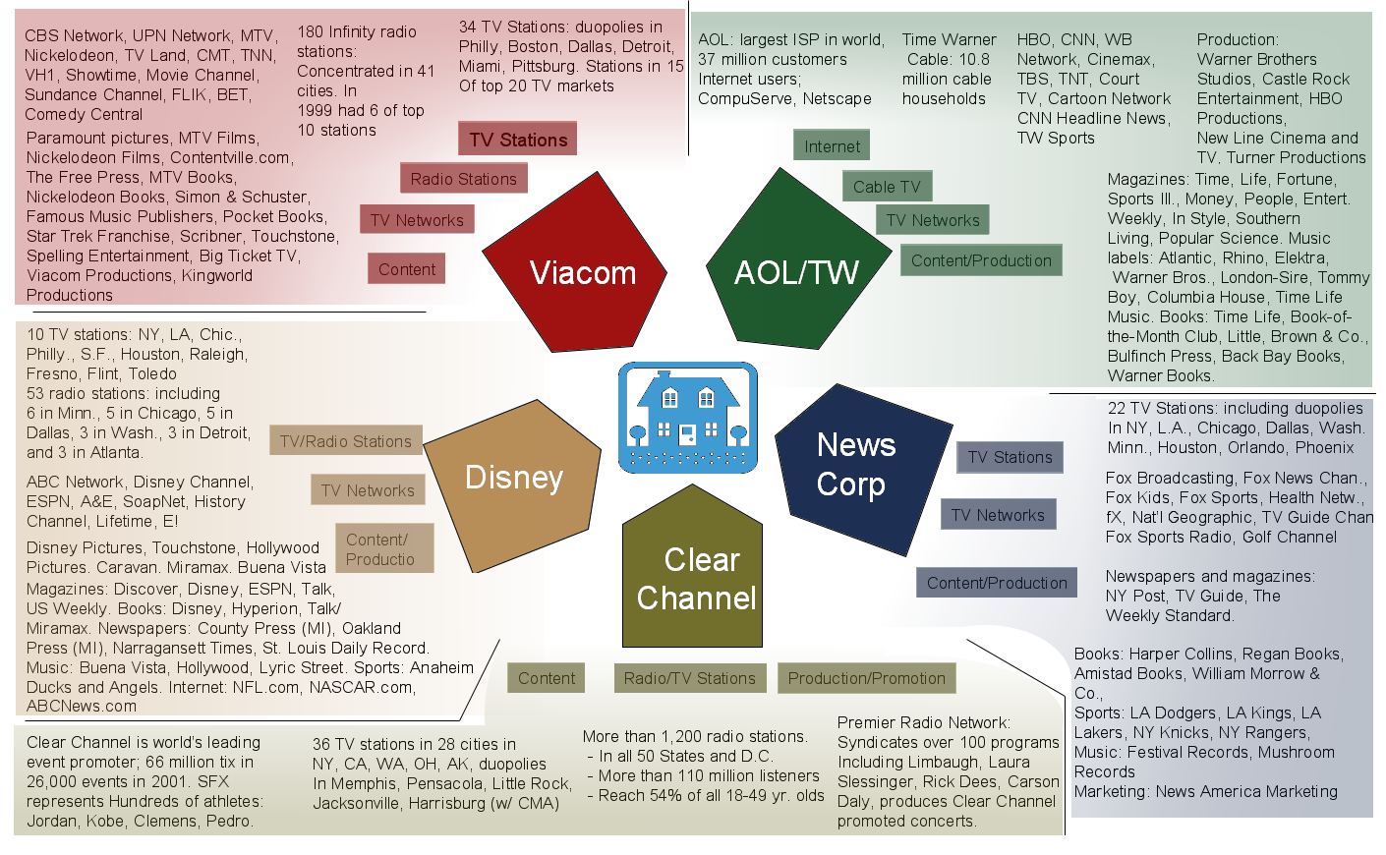

Slide 18
IDEOLOGY

Slide 19
Explicitly or implicitly, the mainstream media convey ideological messages and notions of values, power and authority.
In media literacy, what or who is absent may be more important than what or who is included.

