Slide 1
Introduction to Photography

Slide 2
“Painting or writing with light”

Slide 3
Photography Genres

Slide 4
Documentary/Documentation, Evidence
Reportage, Photojournalism
Landscape, Nature
Portrait
Family history and rituals, snapshots
Street photography
Studio and staged photographs
Advertising
Fashion
Fantasy images, Surrealism
Erotica

Slide 5
Camera Evolution

Slide 6
The Pinhole Camera
A simple camera with no lens and a single small aperture.
It is a light proof box with a small hole. The light passes through and burns the image onto the special paper in the box.
The human eye works similarly, as to most other cameras.

Slide 7
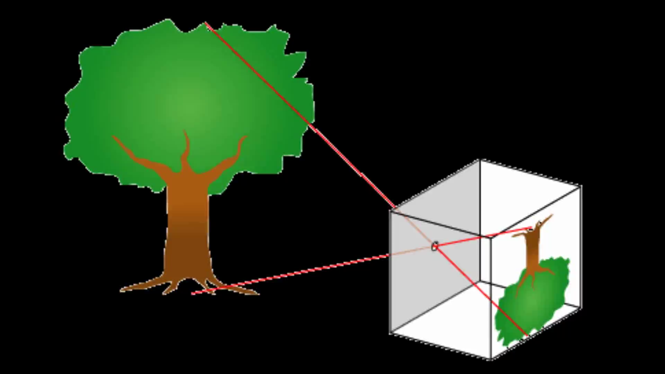

Slide 8
35 mm Camera
This camera works similarly to the Pin Hole camera, but it was created to take more pictures with more precision.
You can control the camera and thus control the outcome of your photographs.

Slide 9
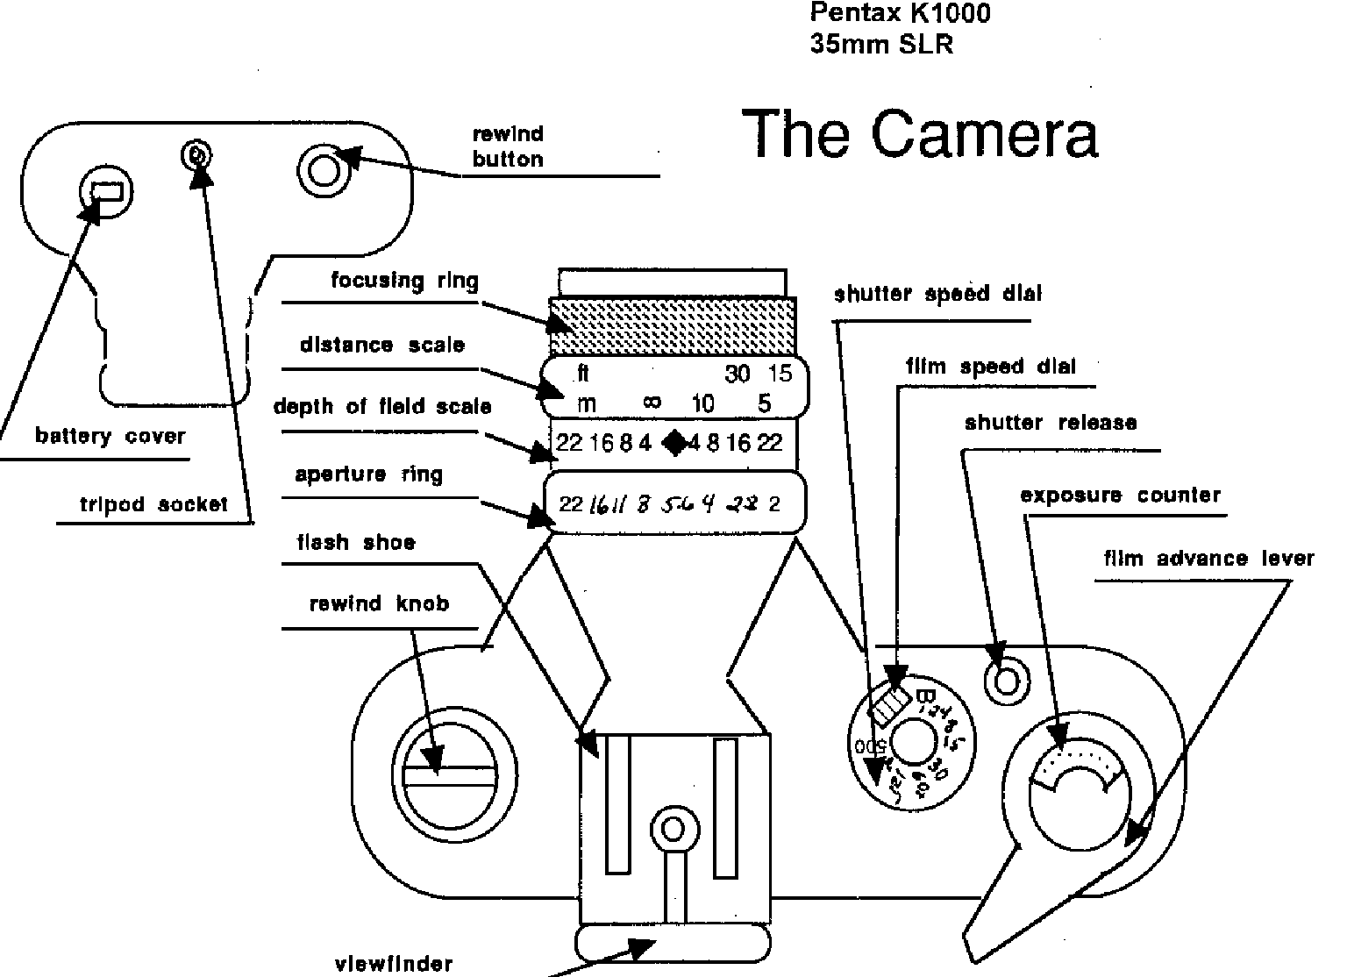

Slide 10
The Digital Camera
Digital cameras work similarly to any other type of camera. They also focus light using the shutter and aperture but instead of burning the image using chemicals, they produce a digital image.
The digital (electronic) aspect allows us to view the images immediately.

Slide 11
Terminology

Slide 12
Aperture
The opening in a lens that controls the exposure of light that passes into the camera.

Slide 13
Exposure
The amount of light you expose the film to when taking a picture.
Overexposure
Underexposure
Normal exposure

Slide 14
Shutter Speed
The speed at which the aperture opens and closes. It helps determine how much light we let in to expose the image you are trying to photograph.

Slide 15
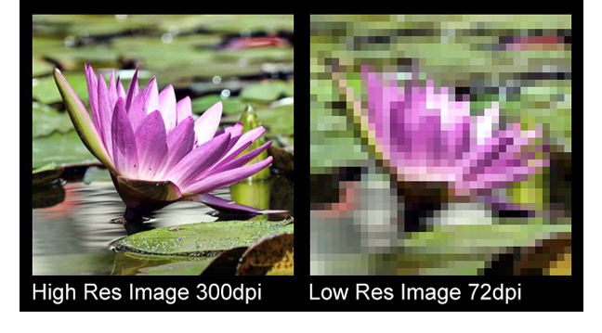
Resolution

Slide 16
Pixel
A picture element. The smallest unit of digital image, which are usually invisible to the naked eye.

Slide 17
Definition
The clarity of detail and edge sharpness in a photograph.

Slide 18
“Taking a picture” vs. “Making a photograph”

Slide 19
Background
The part of a scene that appears behind the main subject of the photograph and farthest away from the camera.

Slide 20
Camera Angle
Various positions of camera placement relative to the subject’s position.
High, low, left, right, eye level, waist level, ground level, birds eye…

Slide 21
Depth of Field
The range of acceptably sharp focus between the nearest and the farthest objects in a photograph. It is controlled by the aperture.

Slide 22
Foreground
The part of the scene or space in a photograph that appears closest to the camera or nearest the viewer.

Slide 23
Light
Daylight- the sun
Existing/Available light- any light that is provided
Tungsten-lamp light
Florescent-Artificial light that lacks red
Window- soft and natural
Hard- produced by a light source that is smaller in size compared to the subject. Produces shadows
Soft- produced by light that is larger then the subject.

Slide 24
Rule of Thirds

Slide 25
Why?
The rule of thirds is used by aligning a subject with the guide lines and their intersection points, placing the horizon on the top or bottom line.
The main reason for observing the rule of thirds is to discourage placement of the subject at the center, or prevent a horizon from appearing to divide the picture in half.

Slide 26
It is common to line the body up to a vertical line and the person's eyes to a horizontal line.

