Slide 2
What is CODING?

Slide 3
Coding is what makes it possible for us to create computer software, apps and websites.

Slide 4
Your browser, your OS, the apps on your phone, Facebook, our class website – they’re all made with code.

Slide 6
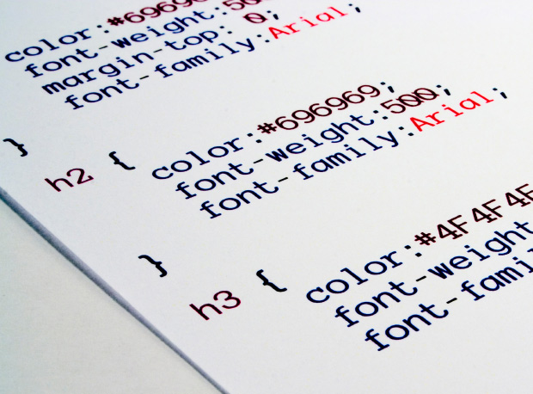

Slide 7
How programming works…
Despite what you may think, computers are very simple machines.

Slide 8
How programming works…
Despite what you may think, computers are very simple machines.
They were created using BINARY CODE

Slide 9
How programming works…
Despite what you may think, computers are very simple machines.
They were created using BINARY CODE
…a series of 1s and 0s that represent stuff.

Slide 10
Coding Languages

Slide 11
All software is written in some kind of programming language.
Every programming language is unique, designed with a certain operating system, programming style and intended use in mind.

Slide 12
Basically…
they are special commands, abbreviations and ways of arranging text.

Slide 13
HTML
or Hyper Text Markup Language, is a code that’s used to write and structure every page on the Internet.

Slide 14
CSS
or Cascading Style Sheets, is an accompanying code that describes how to display HTML.

Slide 15
Both codes are important in today’s Internet-focused world.

Slide 16
Both codes are important in today’s Internet-focused world.
HUGELY

Slide 17
Java Script
… is a high-level interpreted scripting language. Its main platform is web browsers, but it’s also gained recent popularity on web servers.

Slide 18
Java Script
… is a high-level interpreted scripting language. Its main platform is web browsers, but it’s also gained recent popularity on web servers.
function myFunction(a, b) {
return a * b;
}
document.getElementById("demo").innerHTML = myFunction
(4, 3);

Slide 19
Java
… is a high-level compiled language and is designed to run on just about any operating system.

Slide 20
Java
… is a high-level compiled language and is designed to run on just about any operating system.
Nowadays, it is used to create most Android Apps and web pages.

Slide 21
C++
C++ is a compiled language and runs on multiple hardware platforms.

Slide 22
C++
C++ is a compiled language and runs on multiple hardware platforms.
…Most computer games are written in C++. Also, Windows operating system was created with it.

Slide 23
Why bother learning to code?

Slide 25
www.code.org

